Slide 1
Dr. S . Paulraj
Professor of Mathematics
Anna University Chennai

Slide 2
THE ORIGINS OF OPERATIONS RESEARCH
The term Operations Research was first coined in 1940 by McClosky and Trefthen in a small town Bowdsey of the U.K. This new science came into existence in military context. During Word War II (1939-1945), Britain was having very limited military resources, therefore there was an urgent need to allocate scarce resources to the various military operations and to the activities within each operation in an effective manner. Therefore, the British and then the U.S. military management called upon a large number of scientists to apply a scientific approach to dealing with this and other strategic and tactical problems. Because the team was dealing with research on military operations, this new scientific approach was called Operational Research and later it was adopted by U.S.A. as Operations Research (abbreviated as O.R.)

Slide 3
In the decades after the war, the techniques began to be applied more widely to problems in business, industry and society. Since that time, Operations Research has expanded into a field widely used in industries ranging from petrochemicals to airlines, finance, logistics and Government, moving to a focus on the development of mathematical models that can be used to analyse and optimize complex systems and has become an area of active academic and industrial research.

Slide 4
In this context, the first mathematical O.R. technique (which turned out to be a powerful tool in O. R. later) called the Simplex method was developed by the American mathematician Dantzig of Rand Corporation in the US. Since then, various O.R. techniques have been developed and used in several fields (apart from military and industry), such as city planning, railways, airlines, hospital management, library management.

Slide 5
DEVELOPMENT OF OPERATIONS RESEARCH IN INDIA
In India, Operations Research came into existence in the year 1949, with the establishment of an Operations Research unit at the regional research laboratory Hyderabad, for the purpose of planning and organizing research. At the same time Prof. R.S. Verma (Delhi University) set up an OR team in defence science laboratory (later named Defence Science Centre) for the specific purpose of solving the problems of storing, planning and purchasing. Operations Research received a further boost with the setting up on an Operations Research team in the Indian Statistical Institute, Kolkata by Prof. P.C. Mahalanobis in 1953 for solving the problems related to national planning and survey. Later, the Operations Research Society of India (ORSI) was established in 1959. This society started publishing its journals OPSEARCH in 1964.
Prof. Mahalanobis, first applied OR in India by formulating second five year plan with the help of OR techniques. Planning Commission made the use of OR techniques for planning the optimum size of the Caravelle Fleet of Indian airlines.

Slide 6
DEFINITION OF OPERATIONS RESEARCH
Operations Research is the applications of the methods of mathematical science to complex problems arising in the direction and management of large system of men, machines, materials and money in industry, business, government and defence. The distinctive approach is to develop a scientific model of systems incorporating measurements of factors such as chance and risk with which to predict and compare the outcomes of alternatives, decisions, strategies or controls. The purpose is to help management determine its policy and actions scientifically.

Slide 7
Examples of OR Applications
Rescheduling aircraft in response to groundings and delays
Planning production for printed circuit board assembly
Scheduling equipment operators in mail processing & distribution centers
Developing routes for propane delivery
Adjusting nurse schedules in light of daily fluctuations in demand

Slide 8
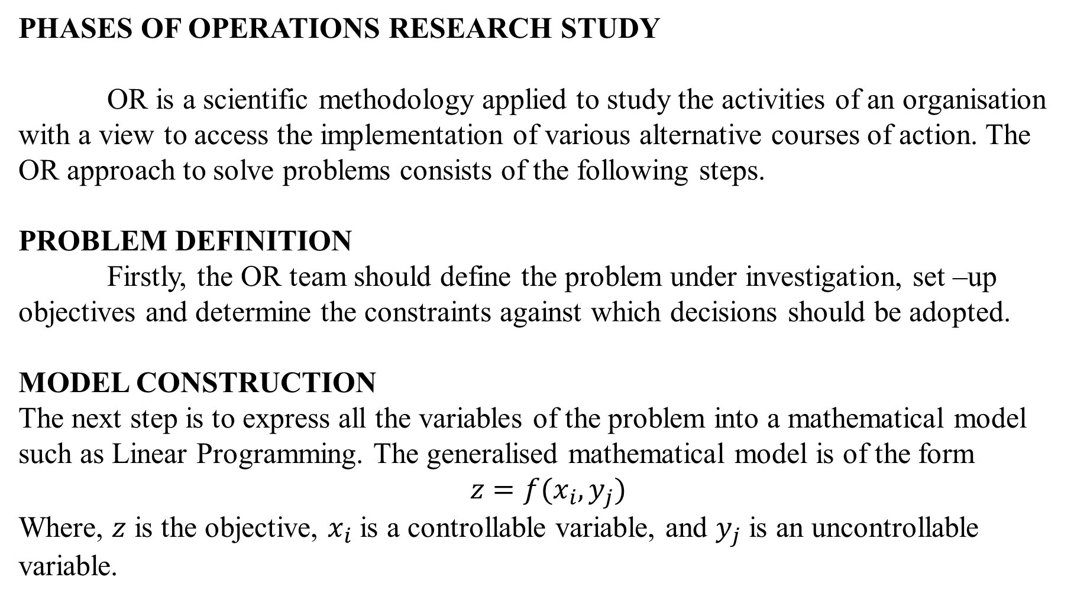
PHASES OF OPERATIONS RESEARCH STUDY
OR is a scientific methodology applied to study the activities of an organisation with a view to access the implementation of various alternative courses of action. The OR approach to solve problems consists of the following steps.
PROBLEM DEFINITION
Firstly, the OR team should define the problem under investigation, set –up objectives and determine the constraints against which decisions should be adopted.
MODEL CONSTRUCTION
The next step is to express all the variables of the problem into a mathematical model such as Linear Programming. The generalised mathematical model is of the form
$$z=f(x_{i},y_{j})$$
Where, $z$ is the objective, $x_{i}$ is a controllable variable, and $y_{j}$ is an uncontrollable variable.

Slide 9
MODEL SOLUTION
In the next step, the values of decision variables that optimise the given objective function are determined. It deals with the mathematical calculations used to obtain model solution.
MODEL VALIDITY
It is the measure of accuracy. A model is valid or accurate if all the objectives, constraints and variables included in the model are relevant and the functional relationships are valid. If the proposed model is representing a new system, no historical data would be available to make the comparison. In such cases, we may use simulation as an independent tool for verifying the output of the mathematical model.
Implementation
Finally, the tested results of the model are implemented. Implementation involves the translation of the results into understandable operating instructions to the managers.

Slide 10
Operations Research Models
Deterministic Models Stochastic Models
• Linear Programming • Discrete-Time Markov Chains
• Network Optimization • Continuous-Time Markov Chains
• Integer Programming • Queuing Theory (waiting lines)
• Nonlinear Programming • Decision Analysis
Inventory Models Game Theory
Inventory models
Simulation

Slide 11
FEATURES OF OR
Using OR approach,
A decision maker can solve a complex problem involving multiple variables more quickly.
A decision maker can examine a situation from various angles by simulating the model constructed for the real problem.
A decision maker can change various conditions of the problem under consideration and determine the optimal solution by examining the effect of changes through experiments on the model.

Slide 12
LIMITATIONS OF OR
Construction of OR model for solving certain problems is too expensive.
OR model constructed may not represent the real world problem for which the decision has to be made.
If the basic data are subject to frequent changes, modification of the OR models becomes costly.
Other shortcomings are the magnitude of computation involved, lack of consideration for non- quantifiable factors, etc.

